Slide 1
CAR SALES PRICE PREDICTION
BY:YABASA HILDA
13/9/2024

Slide 2
Introduction
In this project we are going to predict the price of cars sales. This is important in various ways such us:
1.Helping car manufacturers and car dealerships to forecast future sales trends and adjust production levels.
2.Car buyers can use price predictions to make informed purchasing decisions, like identifying the best time to buy a car or understanding how factors like brand, features, and resale value affect pricing.
3.Predicting the resale value helps consumers and businesses understand the depreciation trends and make better long-term investment decisions.

Slide 3
Introduction cont.
In this project I aim to develop a predictive model that accurately estimates car prices based on various features like engine size, horsepower, vehicle type, power performance factors etc.
To provide stakeholders like car manufacturers, dealers, financial institutions, and buyers with a reliable tool for making informed decisions on pricing strategies, financing, and purchasing.

Slide 4
Dataset Overview
Data Source
The dataset is from Kaggle. You can access the data using the link below: https://www.kaggle.com/datasets/gagandeep16/car-sales

Slide 5
Dataset Overview cont:
Key Variables
The dataset contains the columns:
Manufacturer | Vehicle_type | Horsepower | Curb_weight | Power_perf_factor
Sales_in_thousands | Price_in_thousands | Wheelbase Width | Fuel_capacity | Age
year_resale_value | Engine_size | Length | Fuel_efficiency | Model

Slide 6
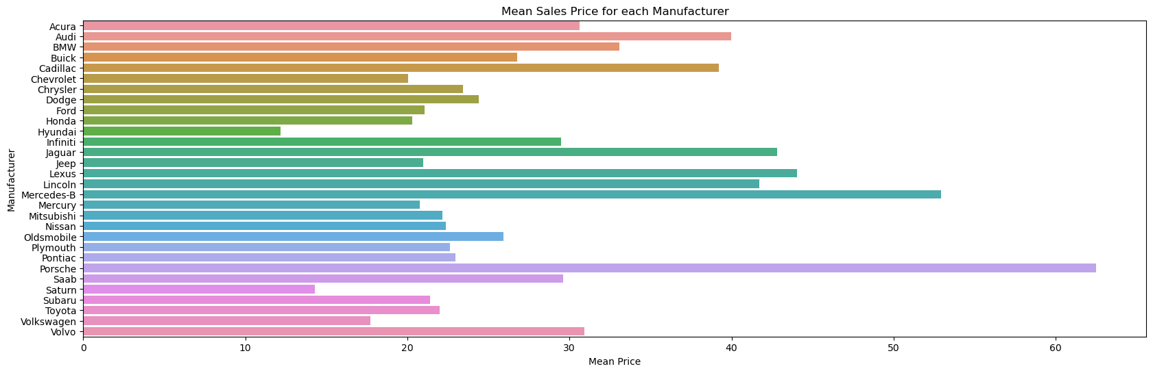
Dataset Overview cont:
Key variables
1.Manufacturer
The dataset had 30 unique manufacturers distributed as shown below with their respective mean price:
Porsche is the most expensive car while Hyundai is the cheapest car.

Slide 7
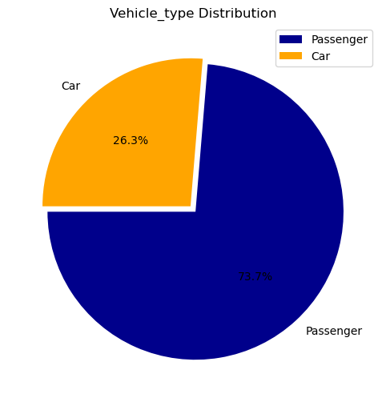
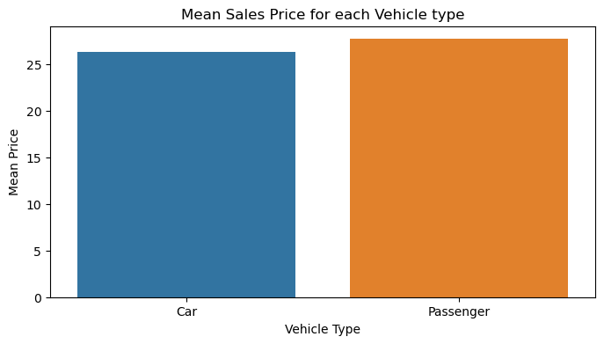
Dataset Overview cont:
Key variables
2.Vehicle_type
The dataset had 2 unique values for the types of vehicle mainly “passenger” and “car”. The number of passenger cars are 112 while that of cars are 40. We can also see that the passenger vehicle type is more expensive.

Slide 8
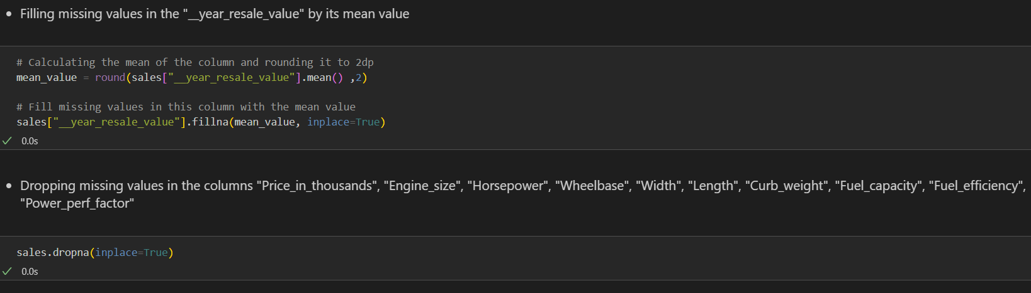
Dataset Overview cont:
Data Preprocessing
Our dataset had various missing values in most of the columns. Columns with less than 5 missing datapoints were dropped while the column “__year_resale_value” which had 36 missing datapoints were filled with the mean value of the values in column.

Slide 9
Dataset Overview cont:
The Dataset consists of 2 datatypes namely “float” and “object”.
We later dropped the column "Model" because it has 156 unique values meaning each row has a specific model name which will make it hard during prediction

Slide 10
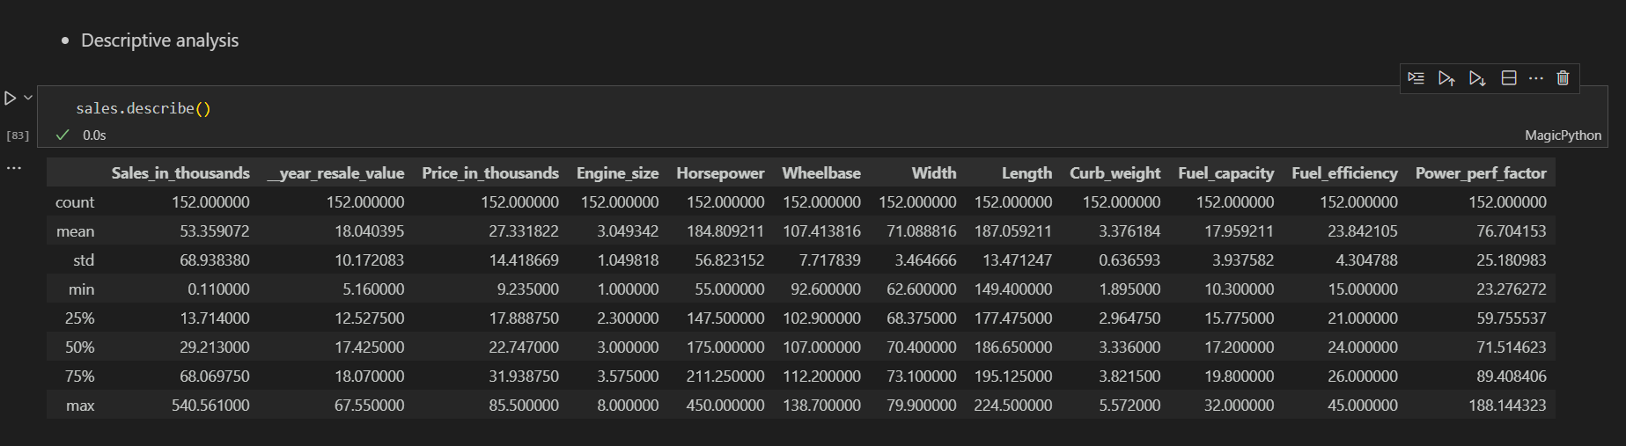
Exploratory Data Analysis(EDA)
Descriptive Analysis
Some basic statistics for numerical values.

Slide 11
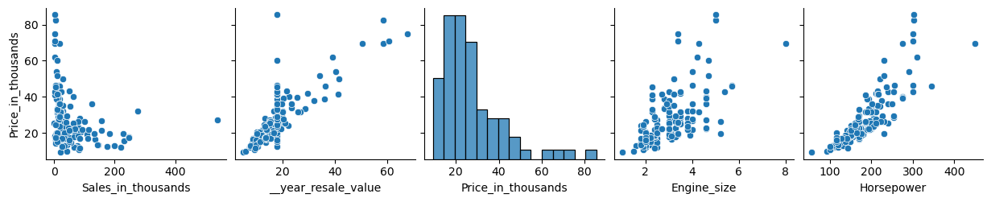
Exploratory Data Analysis(EDA) Cont:
Comparing scatter plot between the target variable “Price_in_thousands” and the numerical features. We can see that the relationship is mostly linear and the increase of this features leads to the increase of the price.

Slide 12
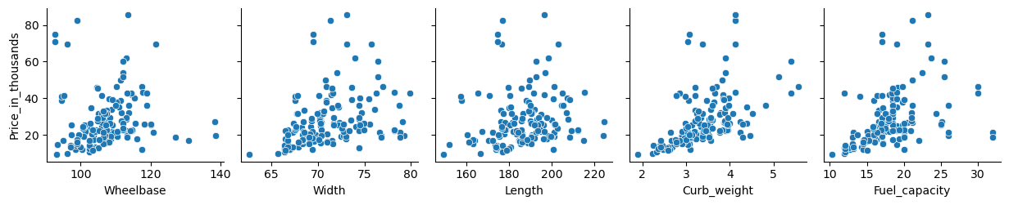
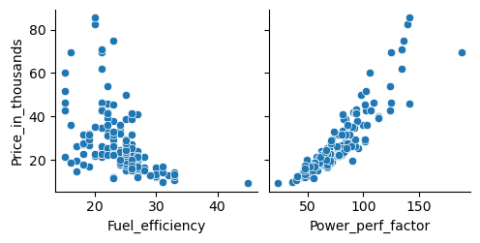
Exploratory Data Analysis(EDA) Cont: Comparing scatter plot between the target variable “Price_in_thousands” and the numerical features

Slide 13
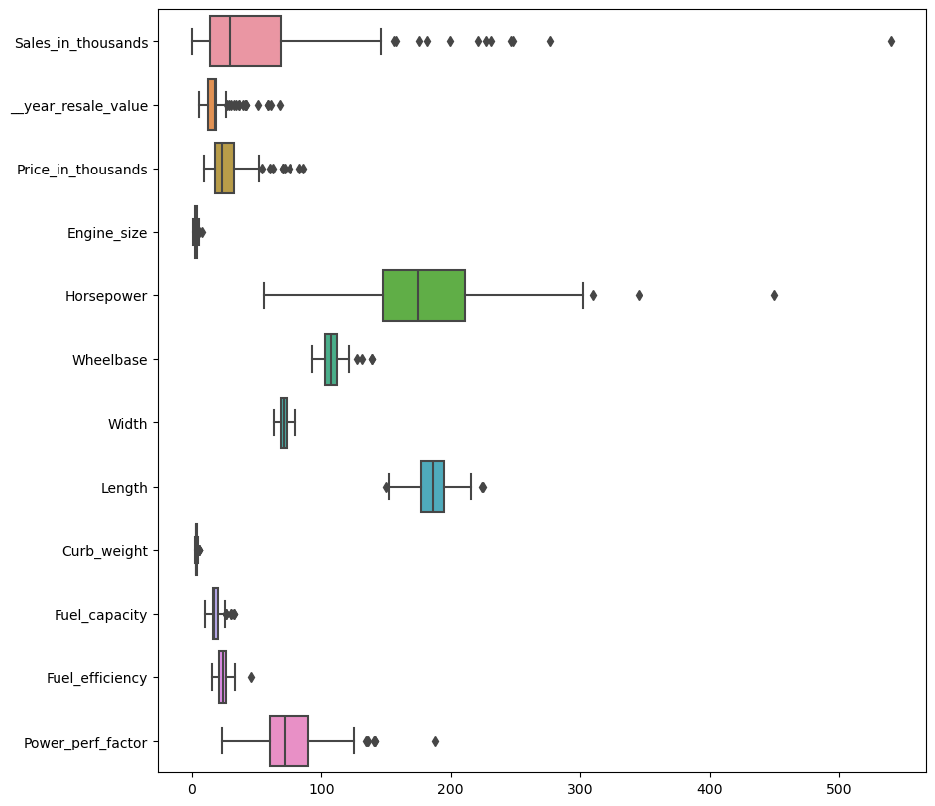
Data Preprocessing
Feature selection
I used all the columns for my model .
Handling Outliers
All columns were seen to contain outliers in a boxplot representation. This extreme values were then dropped using the Interquartile Range Method

Slide 14
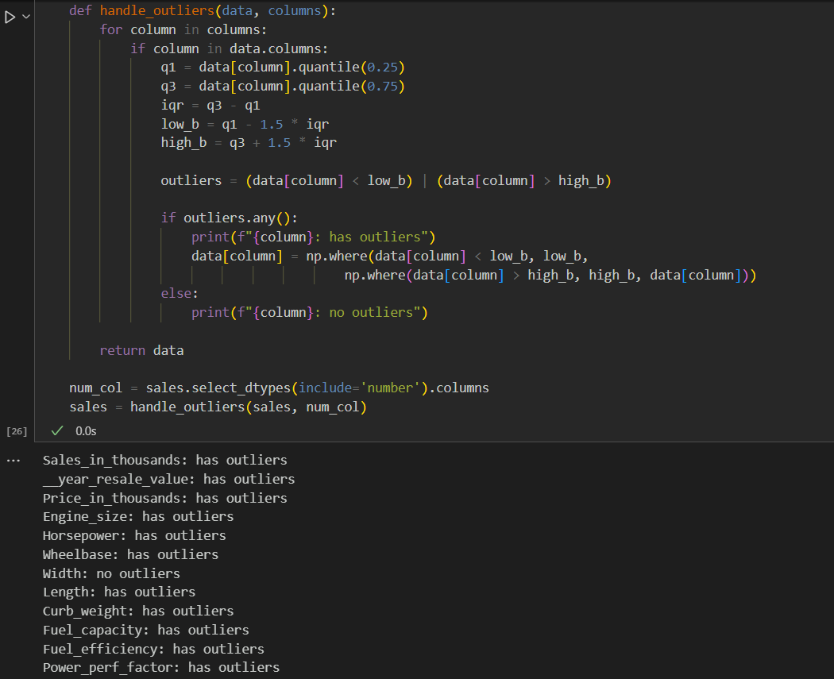
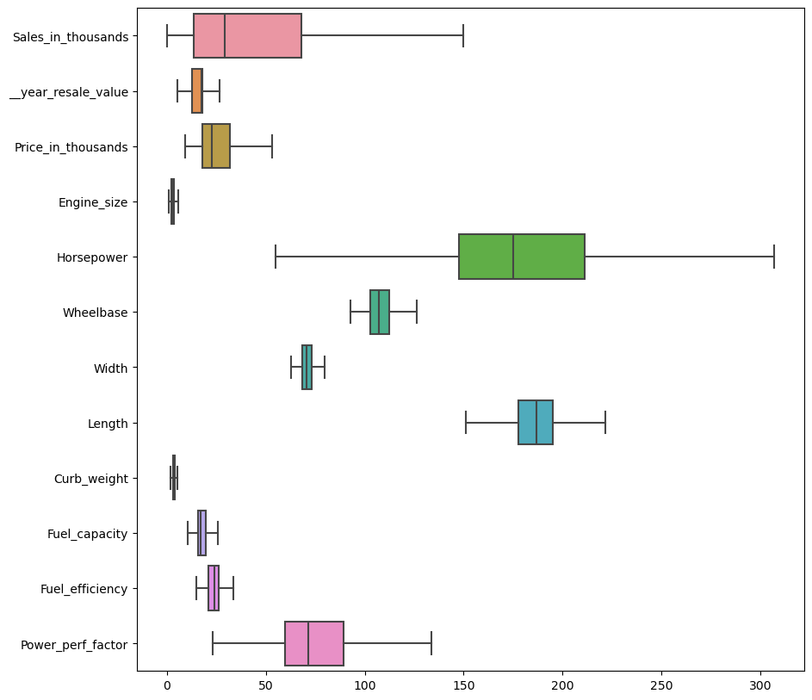
Data Preprocessing Cont:
Handling outliers

Slide 15
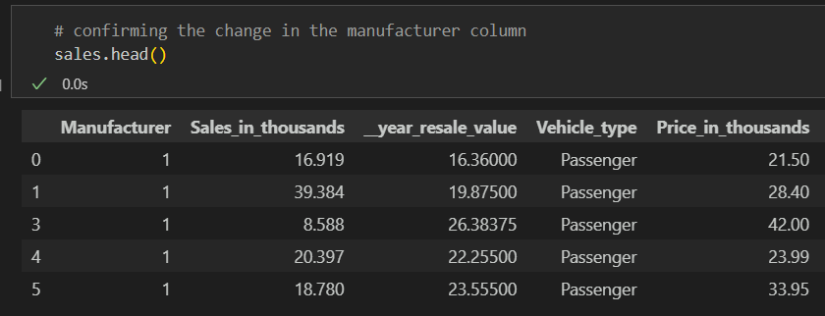
Data Preprocessing Cont:
Feature Engineering
We create new features from the existing “Manufacturer” and “Age” to improve the performance of machine learning models by transforming raw data into more meaningful representations
Manufacturer
Splitting the Manufacturer column in two such that if the mean price of a manufacturer is less than 30 then it belongs to the value 1 and if the mean price is more than 30 it belongs to class 2

Slide 16
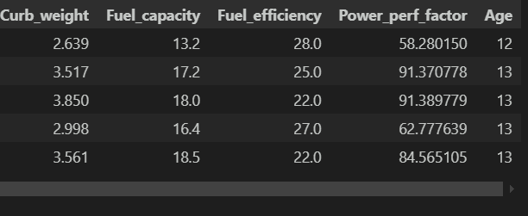
Data Preprocessing Cont:
Age
We will create an age column by using the formula 2024 - year value

Slide 17
Data Preprocessing Cont:
Checking for skewness in the data
All columns were slightly skewed which could negatively impact the performance of our model. Since we will be using a linear regression model assume a normal distribution .If the data is highly skewed, these models may not perform optimally, leading to biased predictions, poor generalization, or inefficiencies in model training.
We reduce this skewed data using Box Cox transformation that is a more general transformation that adjusts based on a parameter to reduce skewness.

Slide 18
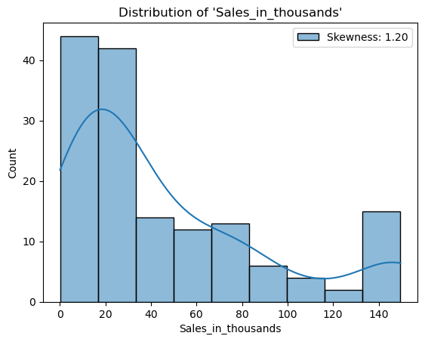
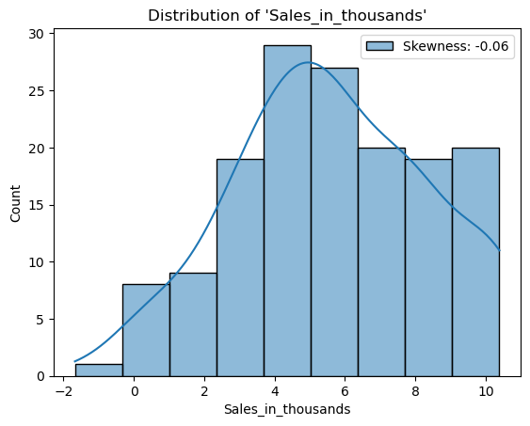
Data Preprocessing Cont:
Checking for skewness in the data
E.g Sales_in_thousands column

Slide 19
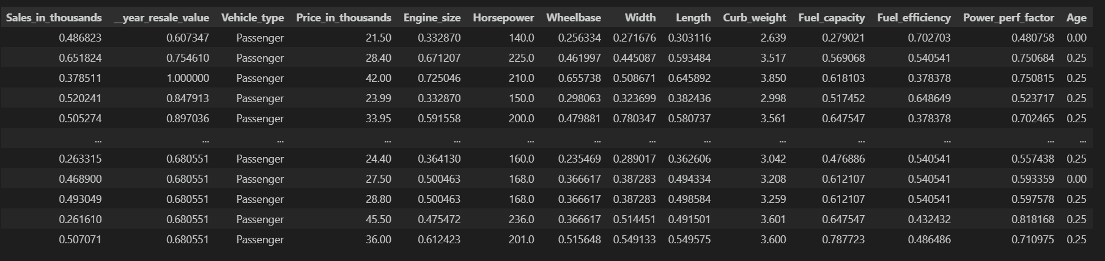
Data Preprocessing Cont:
Normalizing numerical columns
Since features have different scales such us “length” having meters squared, “price” containing Kenyan Shillings, Normalization ensures that each feature contributes equally to the analysis bringing them to the same scale, typically between 0 and 1.
We will use min-max Normalization methos which scales the values of each feature to range between 0 and 1

Slide 20
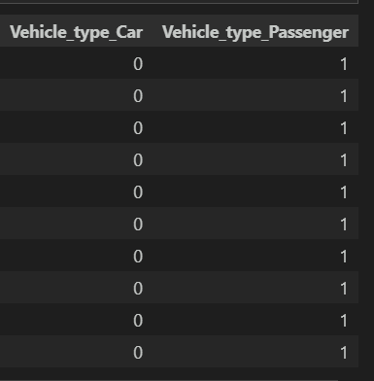
Data Preprocessing Cont:
Feature Encoding
Since the column “Vehicle_type” is categorical we will need to turn it into numerical data for our Machine Learning algorithm.
One-hot-encoding is used with pd.get_dummies which transform categorical columns into one or more numerical columns. The categories in the “Vehicle_type” column will be treated as distinct values.

Slide 21
Modelling
For my work I settled on using a Multiple Regression Model and Decision Tree Model
1.Multiple Regression Model
I used a multiple regression model to clearly understand the linear relationships between key features, such as engine size and fuel efficiency, and car prices, and to make interpretable predictions.
2.Decision Trees
I included a decision tree model to capture non-linear relationships and interactions between car features, providing a more flexible approach to prediction when the linear assumptions of regression models may not hold.
Decision trees can capture interactions between different features, such as how engine size and fuel efficiency together influence price, and can model non-linear relationships that regression models might miss.

Slide 22
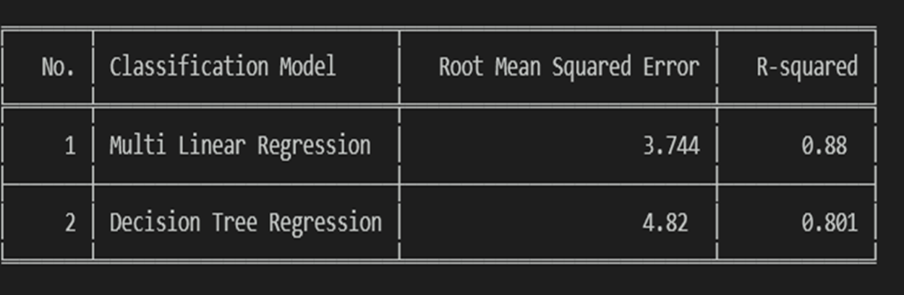
Modelling Cont:
The Multi-LinearRegression Model turned ot to be the best to use giving us a R-squared value of 0.88

Slide 23
.
THANK YOU

